Slide 1
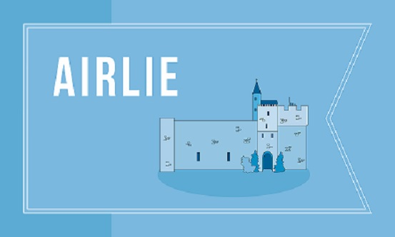
House Structure and Support
Each House has 2 Guidance Teachers. Each pupil has a designated Guidance Teacher.
Support for Learning
Curriculum
Specialist Support
External Support
Pupil Leadership
Parental Support

